Slide 1


The PiXL Club The PiXL Club The PiXL Club The PiXL Club The PiXL Club The PiXL Club The PiXL Club The PiXL Club The PiXL Club The PiXL Club The PiXL Club The PiXL Club The PiXL Club The PiXL Club The PiXL Club The PiXL Club The PiXL Club The PiXL Club The PiXL Club The PiXL Club The PiXL Club The PiXL Club The PiXL Club The PiXL Club The PiXL Club The PiXL Club The PiXL Club The PiXL Club The PiXL Club The PiXL Club The PiXL Club The PiXL Club The PiXL Club The PiXL Club The PiXL Club The PiXL Club The PiXL Club The PiXL Club The PiXL Club The PiXL Club The PiXL Club The PiXL Club The PiXL Club The PiXL Club The PiXL Club XL Club The PiXL Club The PiXL Club The PiXL Club The PiXL Club The PiXL Club The PiXL Club The PiXL Club The PiXL Club The PiXL Club The PiXL Club The PiXL Club The PiXL Club The PiXL Club The PiXL Club The PiXL Club The PiXL Club The PiXL Club The PiXL Club The PiXL Club The PiXL Club The PiXL Club The PiXL Club The PiXL Club The PiXL Club The PiXL Club The PiXL Club The PiXL Club The PiXL Club The PiXL Club The PiXL Club The PiXL Club The PiXL Club The PiXL Club The PiXL Club The PiXL Club The PiXL Club The PiXL Club The PiXL Club The PiXL Club The PiXL Club The PiXL Club The PiXL Club The PiXL Club The PiXL Club The PiXL Club The PiXL Club The PiXL Club The PiXL Club The PiXL Club The PiXL Club The PiXL Club The PiXL Club The PiXL Club The PiXL Club The PiXL Club The PiXL Club The PiXL Club The PiXL Club The PiXL Club The PiXL Club The PiXL Club The PiXL Club The PiXL Club The PiXL Club The PiXL Club The PiXL Club The PiXL Club The PiXL Club The PiXL Club The PiXL Club The PiXL Club The PiXL Club The PiXL Club The PiXL Club The PiXL Club The PiXL Club The PiXL Club The PiXL Club The PiXL Club The PiXL Club The PiXL Club The PiXL Club The PiXL Club The PiXL Club The PiXL Club The PiXL Club The PiXL Club The PiXL Club The PiXL Club The PiXL Club The PiXL Club The PiXL Club The PiXL Club The PiXL Club The PiXL Club The PiXL Club The PiXL Club The PiXL Club The PiXL Club The PiXL Club The PiXL Club The PiXL Club The PiXL Club The PiXL Club The PiXL Club The PiXL Club The PiXL Club The PiXL Club The PiXL Club The PiXL Club The PiXL Club The PiXL Club The PiXL Club The PiXL Club The PiXL Club The PiXL Club The PiXL Club The PiXL Club The PiXL Club The PiXL Club The PiXL Club The PiXL Club The PiXL Club The PiXL Club The PiXL Club The PiXL Club The PiXL Club The PiXL Club The PiXL Club The PiXL Club The PiXL Club The PiXL Club The PiXL Club The PiXL Club The PiXL Club The PiXL Club The PiXL Club The PiXL Club The PiXL Club The PiXL Club The PiXL Club The PiXL Club The PiXL Club The PiXL Club The PiXL Club The PiXL Club The PiXL Club The PiXL Club The PiXL Club The PiXL Club The PiXL Club The PiXL Club The PiXL Club The PiXL Club The PiXL Club The PiXL Club The PiXL Club The PiXL Club The PiXL Club The PiXL Club The PiXL Club The PiXL Club The PiXL Club The PiXL Club The PiXL Club The PiXL Club The PiXL Club The PiXL Club The PiXL Club The PiXL Club The PiXL Club The PiXL Club The PiXL Club The PiXL Club The PiXL Club The PiXL Club The PiXL Club The PiXL Club The PiXL Club The PiXL Club The PiXL Club The PiXL Club The PiXL Club The PiXL Club The PiXL Club The PiXL Club The PiXL Club The PiXL Club The PiXL Club The PiXL Club The PiXL Club The PiXL Club The PiXL Club The PiXL Club The PiXL Club The PiXL Club The PiXL Club The PiXL Club The PiXL Club The PiXL Club The PiXL Club The PiXL Club The PiXL Club The PiXL Club The PiXL Club The PiXL Club The PiXL Club The PiXL Club The PiXL Club The PiXL Club The PiXL Club The PiXL Club The PiXL Club The PiXL Club The PiXL Club The PiXL Club The PiXL Club The PiXL Club The PiXL Club The PiXL Club The PiXL Club The PiXL Club The PiXL Club The PiXL Club The PiXL Club The PiXL Club The PiXL Club The PiXL Club The PiXL Club The PiXL Club The PiXL Club The PiXL Club The PiXL Club The PiXL Club The PiXL Club The PiXL Club The PiXL Club The PiXL Club The PiXL Club The PiXL Club The PiXL Club The PiXL Club The PiXL Club The PiXL Club The PiXL Club The PiXL Club The PiXL Club The PiXL Club The PiXL Club The PiXL Club The PiXL Club The PiXL Club The PiXL Club The PiXL Club The PiXL Club The PiXL Club The PiXL Club The PiXL Club The PiXL Club The PiXL Club The PiXL Club The PiXL Club The PiXL Club The PiXL Club The PiXL Club The PiXL Club The PiXL Club The PiXL Club The PiXL Club The PiXL Club The PiXL Club The PiXL Club The PiXL Club The PiXL Club The PiXL Club The PiXL Club The PiXL Club The PiXL Club The PiXL Club The PiXL Club The PiXL Club The PiXL Club The PiXL Club The PiXL Club The PiXL Club The PiXL Club The PiXL Club The PiXL Club The PiXL Club The PiXL Club The PiXL Club The PiXL Club The PiXL Club The PiXL Club The PiXL Club The PiXL Club The PiXL Club The PiXL Club The PiXL Club The PiXL Club The PiXL Club The PiXL Club The PiXL Club The PiXL Club The PiXL Club The PiXL Club The PiXL Club The PiXL Club The PiXL Club The PiXL Club The PiXL Club The PiXL Club The PiXL Club The PiXL Club The PiXL Club The PiXL Club The PiXL Club The PiXL Club The PiXL Club The PiXL Club The PiXL Club The PiXL Club The PiXL Club The PiXL Club The PiXL Club The PiXL Club The PiXL Club The PiXL Club The PiXL Club The PiXL Club The PiXL Club The PiXL Club The PiXL Club The PiXL Club The PiXL Club The PiXL Club The PiXL Club The PiXL Club The PiXL Club The PiXL Club The PiXL Club The PiXL Club The PiXL Club The PiXL Club The PiXL Club The PiXL Club The PiXL Club The PiXL Club The PiXL Club The PiXL Club The PiXL Club The PiXL Club The PiXL Club The PiXL Club The PiXL Club The PiXL Club The PiXL Club The PiXL Club The PiXL Club The PiXL Club The PiXL Club The PiXL Club The PiXL Club The PiXL Club The PiXL Club The PiXL Club The PiXL Club The PiXL Club The PiXL Club The PiXL Club The PiXL Club The PiXL Club The PiXL Club The PiXL Club The PiXL Club The PiXL Club The PiXL Club The PiXL Club The PiXL Club The PiXL Club The PiXL Club The PiXL Club The PiXL Club The PiXL Club The PiXL Club The PiXL Club The PiXL Club The PiXL Club The PiXL Club The PiXL Club The PiXL Club The PiXL Club The PiXL Club The PiXL Club The PiXL Club The PiXL Club The PiXL Club The PiXL Club The PiXL Club The PiXL Club The PiXL Club The PiXL Club The PiXL Club The PiXL Club The PiXL Club The PiXL Club The PiXL Club The PiXL Club The PiXL Club The PiXL Club The PiXL Club The PiXL Club The PiXL Club The PiXL Club The PiXL Club The PiXL Club The PiXL Club The PiXL Club The PiXL Club The PiXL Club The PiXL Club The PiXL Club The PiXL Club The PiXL Club The PiXL Club The PiXL Club The PiXL Club The PiXL Club The PiXL Club The PiXL Club The PiXL Club The PiXL Club The PiXL Club The PiXL Club The PiXL Club The PiXL Club The PiXL Club The PiXL Club The PiXL Club The PiXL Club The PiXL Club The PiXL Club The PiXL Club The PiXL Club The PiXL Club The PiXL Club The PiXL Club The PiXL Club The PiXL Club The PiXL Club The PiXL Club The PiXL Club The PiXL Club The PiXL Club The PiXL Club The PiXL Club The PiXL Club The PiXL Club The PiXL Club The PiXL Club The PiXL Club The PiXL Club The PiXL Club The PiXL Club The PiXL Club The PiXL Club The PiXL Club The PiXL Club The PiXL Club The PiXL Club The PiXL Club The PiXL Club The PiXL Club The PiXL Club The PiXL Club The PiXL Club The PiXL Club The PiXL Club The PiXL Club The PiXL Club The PiXL Club The PiXL Club The PiXL Club The PiXL Club The PiXL Club The PiXL Club The PiXL Club The PiXL Club The PiXL Club The PiXL Club The PiXL Club The PiXL Club The PiXL Club The PiXL Club The PiXL Club The PiXL Club The PiXL Club The PiXL Club The PiXL Club The PiXL Club The PiXL Club The PiXL Club The PiXL Club The PiXL Club The PiXL Club The PiXL Club The PiXL Club The PiXL Club The PiXL Club The PiXL Club The PiXL Club The PiXL Club The PiXL Club The PiXL Club The PiXL Club The PiXL Club The PiXL Club The PiXL Club The PiXL Club The PiXL Club The PiXL Club The PiXL Club The PiXL Club The PiXL Club The PiXL Club The PiXL Club The PiXL Club The PiXL Club The PiXL Club The PiXL Club The PiXL Club The PiXL Club The PiXL Club The PiXL Club The PiXL Club The PiXL Club The PiXL Club The PiXL Club The PiXL Club The PiXL Club The PiXL Club The PiXL Club The PiXL Club The PiXL Club The PiXL Club The PiXL Club The PiXL Club The PiXL Club The PiXL Club The PiXL Club The PiXL Club The PiXL Club The PiXL Club The PiXL Club The PiXL Club The PiXL Club The PiXL Club The PiXL Club The PiXL Club The PiXL Club The PiXL Club The PiXL Club The PiXL Club The PiXL Club The PiXL Club The PiXL Club The PiXL Club The PiXL Club The PiXL Club The PiXL Club The PiXL Club The PiXL Club The PiXL Club The PiXL Club The PiXL Club The PiXL Club The PiXL Club The PiXL Club The PiXL Club The PiXL Club The PiXL Club The PiXL Club The PiXL Club The PiXL Club The PiXL Club The PiXL Club The PiXL Club The PiXL Club The PiXL Club The PiXL Club The PiXL Club The PiXL Club The PiXL Club The PiXL Club The PiXL Club The PiXL Club The PiXL Club The PiXL Club The PiXL Club The PiXL Club The PiXL Club The PiXL Club The PiXL Club The PiXL Club The PiXL Club The PiXL Club The PiXL Club The PiXL Club The PiXL Club The PiXL Club The PiXL Club The PiXL Club The PiXL Club The PiXL Club The PiXL Club The PiXL Club The PiXL Club The PiXL Club The PiXL Club The PiXL Club The PiXL Club The PiXL Club The PiXL Club The PiXL Club The PiXL Club The PiXL Club The PiXL Club The PiXL Club The PiXL Club The PiXL Club The PiXL Club The PiXL Club The PiXL Club The PiXL Club The PiXL Club The PiXL Club The PiXL Club The PiXL Club The PiXL Club The PiXL Club The PiXL Club The PiXL Club The PiXL Club The PiXL Club The PiXL Club The PiXL Club The PiXL Club The PiXL Club The PiXL Club The PiXL Club The PiXL Club The PiXL Club The PiXL Club The PiXL Club The PiXL Club The PiXL Club The PiXL Club The PiXL Club The PiXL Club The PiXL Club The PiXL Club The PiXL Club The PiXL Club The PiXL Club The PiXL Club The PiXL Club The PiXL Club The PiXL Club The PiXL Club The PiXL Club The PiXL Club The PiXL Club The PiXL Club The PiXL Club The PiXL Club The PiXL Club The PiXL Club The PiXL Club The PiXL Club The PiXL Club The PiXL Club The PiXL Club The PiXL Club The PiXL Club The PiXL Club The PiXL Club The PiXL Club The PiXL Club The PiXL Club The PiXL Club The PiXL Club The PiXL Club The PiXL Club The PiXL Club The PiXL Club The PiXL Club The PiXL Club The PiXL Club The PiXL Club The PiXL Club
PiXL KnowIT!
GCSE Physics
Edexcel Astronomy (Physics only)
© Copyright The PiXL Club Ltd, 2017
This resource is strictly for the use of member schools for as long as they remain members of The PiXL Club. It may not be copied, sold nor transferred to a third party or used by the school after membership ceases. Until such time it may be freely used within the member school.
All opinions and contributions are those of the authors. The contents of this resource are not connected with nor endorsed by any other company, organisation or institution.
www.pixl.org.uk The PiXL Club Ltd, Company number 07321607

Slide 2
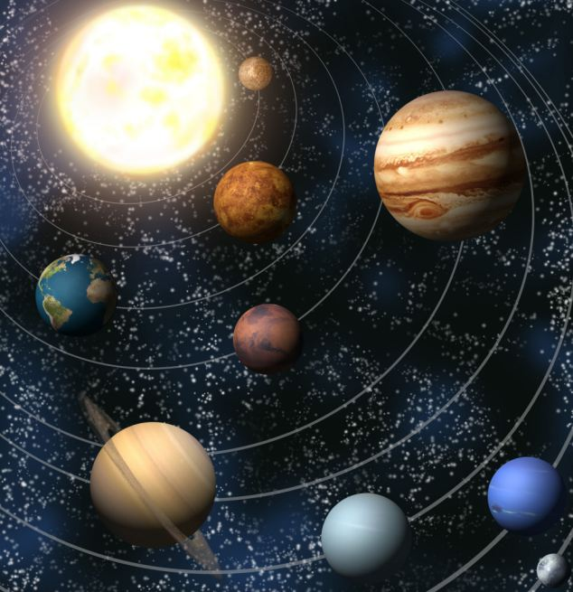
Overview Edexcel Topic 7
Astronomy
Part 1
Solar system
Gravity and orbits
Part 2
Origin of the universe
Redshift
Life cycle of stars

Slide 3
LearnIT!
KnowIT!
Part 1
Solar system
Gravity and orbits

Slide 4
Weight and mass
Weight and mass
Weight is not the same as mass. Mass is a measure of how much ”stuff” or matter there is in an object. Weight is a force acting on that matter.
Weight is the result of gravity.
On Earth gravitational field strength (g) = 10 N/kg)
Recall and use the equation:
weight (N) = mass (kg) × gravitational field strength (N/kg)
W = m × g
On Earth this means that a one kilogram mass would have a weight of 10 N.
The value of the gravitational field strength will depend on where you are. On the Moon your weight will be approximately one sixth of your weight on Earth.

Slide 5
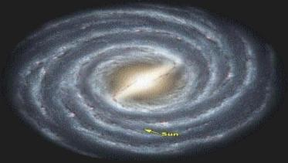
Our solar system
Our solar system is a small part of a galaxy called the Milky Way.
Our star (The Sun) is just one of approximately 300 000 000 000 stars in our galaxy. The whole solar system is too small to see on this picture of the Milky Way.
There is thought to be a massive black hole at the centre of the Milky Way.
The Universe is thought to have formed about 13.7 billion years ago. The solar system formed around 4.6 billion years ago.

Slide 6
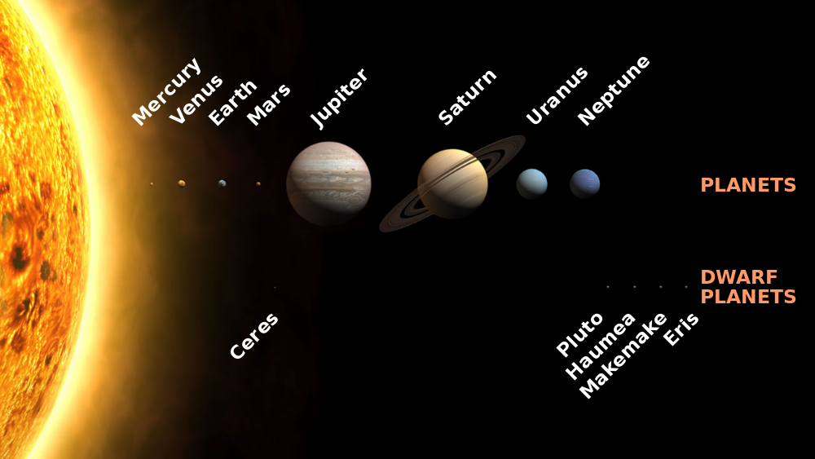
Our solar system
The solar system is any object that is bound by gravity to a Sun.
Our solar system there is:
one star – the Sun
eight planets
dwarf planets
natural satellites called moons that orbit planets.
Other objects include:
Comets
Asteroids
Satellites
Dust, ice and rocks make up the remaining mass.

Slide 7
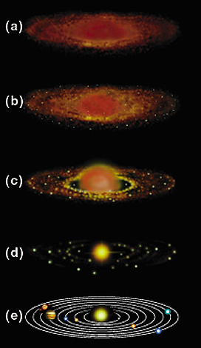
Formation of the sun and solar system
The universe contains ‘clumps’ of dust and gas each called a nebula.
Gravitational attraction pulls this dust and gas together.
Forming the Sun (a star).
Fusion reactions lead to an equilibrium between the gravitational collapse of the star and the expansion of a star due to fusion energy.
The remaining parts of the solar system form from the remaining dust and gas.

Slide 8
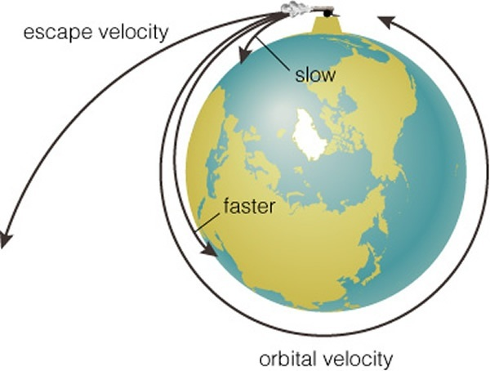
Orbits and speed
Gravity pulls the Earth (and other planets) towards the sun. The planet is effectively “falling” towards the sun but is travelling fast enough so that it constantly misses falling into the sun.
Gravity
Sun
This is like a cannon firing a cannonball at just the right speed so it does not escape into space or fall down to Earth.
This is how planets, moons and artificial satellites remain in orbit around larger objects in space.
The force of gravity increases the closer an object orbits. To avoid being pulled into the sun, a planet must be travelling faster, the closer it is to the sun.
This is why Mercury’s orbit of the sun takes 3 Earth months whereas it takes Neptune 165 Earth years to orbit the sun.

Slide 9
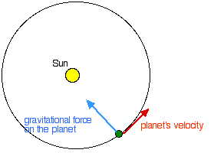
Orbits and speed
In a perfectly circular orbit, a body will travel at constant speed to maintain its orbital distance.
However, gravity is constantly changing the direction of the body. As velocity depends on speed and direction, the velocity is constantly changing even though speed remains the same.
This applies to planets, moons and satellites.
Planets velocity is in a straight line. Gravity causes body to change direction so velocity must be changing

Slide 10
QuestionIT!
Part 1
Solar system
Gravity and orbits

Slide 11
Part 1– QuestionIT
Name the star in our solar system.
How many planets in our solar system?
What is the difference between a moon and a dwarf planet?
What do we call the natural satellites in the solar system?
Name the galaxy our solar system is part of.
How was the sun formed, and what caused this to happen?
List the major bodies found in the solar system.

Slide 12
Part 1– QuestionIT
8. The international space station takes 92 mins to orbit the Earth.
The Moon takes 27.3 days to orbit the Earth. Explain why these
orbital times are different.

Slide 13
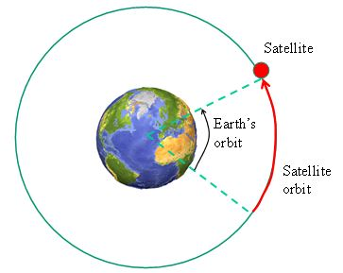
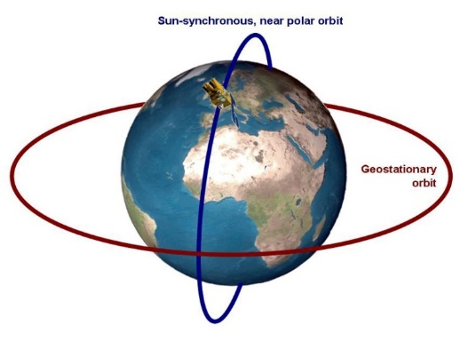
Part 1– QuestionIT
9. The diagram shows a satellite orbiting the Earth.
Explain how the Earth’s gravity can result in the
satellites velocity changing but not its speed.
10. Explain why satellites in a polar orbit must travel at much higher
speeds than a satellite in a geostationary orbit.

Slide 14

AnswerIT!
Part 1
Solar system
Gravity and orbits

Slide 15
Part 1– AnswerIT
Name the star in our solar system.
The Sun.
How many planets in our solar system?
8
What is the difference between a moon and a dwarf planet?
Dwarf planets orbit the sun; moons orbit planets.
What do we call the natural satellites in the solar system?
Moons.
Name the galaxy our solar system is part of.
The Milky Way.
How was the sun formed, and what caused this to happen?
From a cloud of dust and gas (nebula); pulled together by gravitational attraction; causing fusion reactions.
List the major bodies found in the solar system.
Star, planets, dwarf planets, moons, asteroids, comets.

Slide 16
Part 1– AnswerIT
8. The international space station takes 92 mins to orbit the Earth.
The Moon takes 27.3 days to orbit the Earth. Explain why these
orbital times are different.
Moon orbits at a much greater distance than the ISS; it is much further away from the Earth.
The further from the Earth the lower the gravitational attraction
So The Moon travels slower and it takes much longer to orbit the Earth.

Slide 17
Part 1– AnswerIT
9. The diagram shows a satellite orbiting the Earth.
Explain how the Earth’s gravity can result in the
satellites velocity changing but not its speed.
In a circular orbit the speed of the satellite
remains constant. Velocity is a vector so has
size AND direction.
As the direction is changing, the velocity
must be changing.
10. Explain why satellites in a polar orbit must travel at much higher
speeds than a satellite in a geostationary orbit.
Polar satellite are in a much lower orbit than
geostationary satellites.
In a lower orbit, gravity has a much stronger
influence so the polar satellite must travel much
faster to avoid being pulled down to Earth.

Slide 18
LearnIT!
KnowIT!
Part 2
Origin of the universe
Redshift
Life cycle of stars

Slide 19
Steady state vs the Big Bang
Steady State theory | The Universe has always existed and is expanding. New matter continuously created as expansion occurs.
Big Bang theory | The whole Universe and all matter started out as a tiny point of energy. The Universe expanded from this point and is still expanding.
Cosmic Microwave Background radiation (CMBR) Huge amounts of radiation were released at Big Bang. As the universe expanded, the wavelength of radiation has increased. This is detected now as microwave radiation.
More evidence supports The Big Bang theory so it is the current accepted model for the origin of the Universe.
Evidence supporting
Steady State theory | Red-shift
Big Bang theory | Red-shift and CMBR

Slide 20
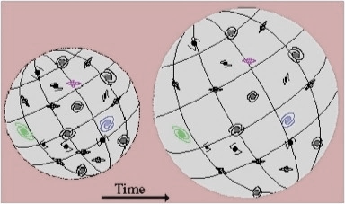
Big Bang theory
Like a balloon expanding, all galaxies are moving away from each other and from a point of origin. Only the fastest moving galaxies would be on the surface of this model. Slower moving galaxies would be on the inside but still moving away from the centre. These observations have provided evidence of an expanding Universe.
Galaxies
Universe expands over time
Red shift measurements of many galaxies have given evidence that all galaxies are moving away from a single point of origin at different speeds. This has led to the Big Bang theory that the Universe expanded from a single point of matter around 13.7 billion years ago.

Slide 21

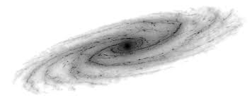
Red shift
There are billions of galaxies in the Universe. We can see them because the stars within them give off light which travels to Earth.
Nearby star
Distant galaxy
Light from a nearby star appears white as the wavelength of light emitted covers the whole visible spectrum.
The light we receive from a distant galaxy has had its wavelength increased. As longer wavelengths of light are the red end of the spectrum, the light appears redder than from the nearby star – this is called RED SHIFT.
Red shift happens because the galaxy is moving away from us at high speed, causing the wavelengths of light to be stretched.

Slide 22
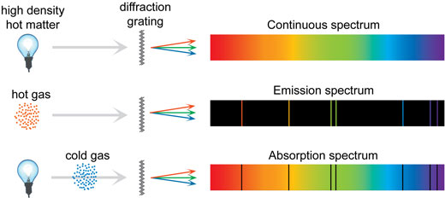
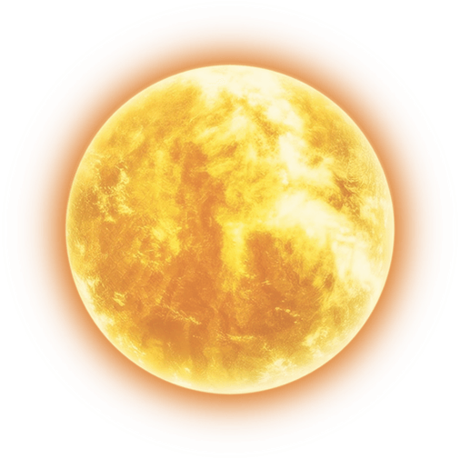
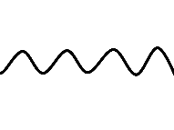
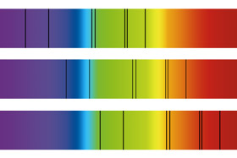
Red shift
Light emitted by a hot object produces a continuous spectrum.
When light is emitted by a star, the light has to travel through the gases which make up the star.
These gases absorb specific wavelengths of light, leaving black lines in the spectrum.
Absorption spectra from stars in every galaxy would look the same if all the galaxies were a fixed distance from the Earth. Galaxies have different amounts of red shift which means they are moving away from us at different speeds.
The faster a galaxy is moving, the further away it is.
Spectrum from a star in our galaxy – no red shift
Spectrum from a star in another galaxy – some red shift
Spectrum from a distant galaxy – a lot of red shift

Slide 23
Red shift
Summary
Red light has a longer wavelength than blue light.
Most distant galaxies show an increase in wavelength of light.
The further away the galaxies the faster they are moving and the bigger the increase in wavelength.
This effect is called the RED-SHIFT.
The observed red-shift provides evidence that the universe is expanding and supports the Big Bang theory.

Slide 24
Life cycle of a star
Stars go through a life cycle which is different for massive stars and smaller stars.
Stars about the same size as the Sun
Small stars live a lot longer than massive stars as they use up their fuel more slowly.
Nebula
(Cloud of gas and dust)
The Sun will be a main sequence star for 20 billion years. Massive stars can last less than a million years.
Stars much bigger than the Sun
Protostar
Main sequence star
Red Giant
Red super giant
White dwarf
Supernova
Black dwarf
Neutron star
Black hole

Slide 25
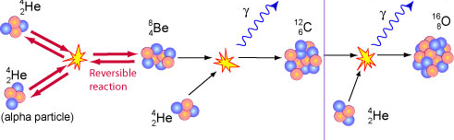


Stars and the elements
Fusion processes in stars produce all of the naturally occurring elements.
Elements heavier than iron are produced in a supernova.
The explosion of a massive star (supernova) distributes the elements throughout the universe.
How fusion processes lead to to the formation of new elements:
Stars begin with hydrogen as their “fuel”. Hydrogen nuclei join to becomes helium during the fusion process. Further fusion processes continue to create larger elements (as big as iron on the periodic table).
Elements bigger than iron are produced in a supernova. The supernovae distribute elements throughout the Universe.

Slide 26
QuestionIT!
Part 2
Origin of the universe
Redshift
Life cycle of stars

Slide 27
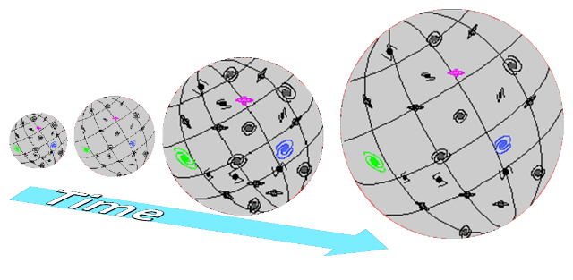
Part 2 – QuestionIT
1. What does the diagram suggest is happening to the Universe over
time?
2. Describe the current theory of how the Universe began.
3. Which colour of light has the longest wavelength?
4. The diagram shows the spectrum of light from a star in our galaxy.
Copy the second box by adding the spectra you would expect from a
star in a distant galaxy.
Blue
Red
Blue
Red

Slide 28
Part 2 – QuestionIT
5. The light reaching Earth from distant galaxies exhibits red shift.
Explain why red shift occurs.
Galaxy A Galaxy B
6. If galaxy A has a much bigger red shift than galaxy B, what does this
tell you about galaxy A?
7. Which theory about the origin of the Universe does red shift of
galaxies support?
8. Approximately how many years ago did the Universe begin? (Circle the correct answer)
14 million 14 billion 14 trillion

Slide 29
Part 2 – QuestionIT
9 . The most distant galaxies in the Universe are thought to be:
(tick the correct box)
The biggest galaxies Accelerating
Slowing down The coldest
10. What is a nebula?
11. What determines the life cycle a star will take?
12. Describe the lifecycle of a star the size of the sun.
13. Describe the lifecycle of a star more massive than the sun.

Slide 30
Part 2 – QuestionIT
14. What processes produce all of the naturally occurring elements?
15. Where are elements heavier than iron produced?
16. How are these elements distributed throughout the universe?

Slide 31
AnswerIT!
Part 2
Origin of the universe
Redshift
Life cycle of stars

Slide 32
Part 2 – AnswerIT
1. What does the diagram suggest is happening to the Universe over
time?
It is expanding.
2. Describe the current theory of how the Universe began.
Started as a small region that was very hot and dense.
Big Bang caused it to rapidly expand.
3. Which colour of light has the longest wavelength?
Red
4. The diagram shows the spectrum of light from a star in our galaxy.
Copy the second box by adding the spectra you would expect from a
star in a distant galaxy.
Blue
Red
Blue
Red

Slide 33
Part 2 – AnswerIT
5. The light reaching Earth from distant galaxies exhibits red shift.
Explain why red shift occurs.
Galaxy is moving away at high speed
Light waves from the galaxy are being stretched to longer wavelengths.
Longer wavelengths of light are found at the red end of the spectrum.
This shift of wavelength is called red shift.
Galaxy A Galaxy B
6. If galaxy A has a much bigger red shift than galaxy B, what does this
tell you about galaxy A?
It is travelling away at a higher speed. It is further away.
7. Which theory about the origin of the Universe does red shift of
galaxies support? Big Bang theory.
8. Approximately how many years ago did the Universe begin? (Circle the correct answer)
14 million 14 billion 14 trillion

Slide 34
Part 2 – AnswerIT
9 . The most distant galaxies in the Universe are thought to be:
(tick the correct box)
The biggest galaxies Accelerating
Slowing down The coldest
10. What is a nebula?
Cloud of dust and gas.
11. What determines the life cycle a star will take?
The size of the star.
12. Describe the lifecycle of a star the size of the sun.
Cloud of gas and dust, protostar, main sequence star, red giant, white dwarf, black dwarf.
13. Describe the lifecycle of a star more massive than the sun.
Cloud of gas and dust, protostar, main sequence star, red super giant, supernova, neutron star or black hole.
✓

Slide 35
Part 2 – AnswerIT
14. What processes produce all of the naturally occurring elements?
Fusion.
15. Where are elements heavier than iron produced?
Supernova.
16. How are these elements distributed throughout the universe?
Explosion of massive star (supernova).

